Slide 1
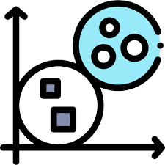
Machine Learning Clustering and Dimensionality Reduction
Week 5
Professor: Omar Altrad, PhD, P.Eng, PMP

Slide 2
Lecture 2: How create an end-to-end machine learning project

Slide 3
Intended Learning Objectives:
Discuss the management process for machine learning projects
Explain feature engineering and selection techniques as part of machine learning model building process
Identify the evaluation techniques used in assessing machine learning projects

Slide 4
Management process for machine learning projects
The management process for machine learning projects involves several key steps to ensure successful development and deployment of machine learning models.
Here is an overview of the typical management process for machine learning projects:
Problem Definition
1
Feature Engineering and Selection
3
Model Selection and Training
4
Model Evaluation
5
Data Collection and Preparation
2
Model Tuning and Optimization
6
Model Deployment
7
Monitoring and Maintenance
8

Slide 5
Problem Definition:
Clearly define the problem you want to solve using machine learning.
This includes understanding the business objective, defining the scope, and setting clear goals for the project.

Slide 6
Data Collection and Preparation:
# Import necessary libraries
import pandas as pd
# Load the dataset
data = pd.read_csv('dataset.csv')
# Define the target variable
target = data['target']
# Define the feature variables
features = data.drop('target', axis=1)
# Handle missing values
features = features.fillna(features.mean())
# Perform feature scaling or normalization
from sklearn.preprocessing import MinMaxScaler
scaler = MinMaxScaler()
features_scaled = scaler.fit_transform(features)
Gather the relevant data required for the project. This may involve:
collecting data from various sources,
cleaning and preprocessing the data,
handling missing values
performing necessary transformations.

Slide 7
Feature Engineering and Selection:
Feature engineering involves creating new features or transforming existing ones to improve the performance of machine learning models.
This process can include techniques like one-hot encoding, scaling, dimensionality reduction, and creating interaction variables.
Feature selection refers to identifying the most relevant features that contribute to the prediction task, using methods like correlation analysis, information gain, or regularization..
# Perform feature selection (example using univariate feature selection)
from sklearn.feature_selection import SelectKBest, f_classif
selector = SelectKBest(score_func=f_classif, k=5)
selected_features = selector.fit_transform(features_scaled, target)

Slide 8
Model Selection and Training
Select the appropriate machine learning algorithm(s) based on the problem at hand and the available data.
This could involve techniques such as decision trees, support vector machines, neural networks, or ensemble methods.
Train the selected model(s) using the prepared dataset.
# Split the dataset into training and testing sets
from sklearn.model_selection import train_test_split
X_train, X_test, y_train, y_test = train_test_split(selected_features, target, test_size=0.2, random_state=42)
# Train a machine learning model (example using a decision tree classifier)
from sklearn.tree import DecisionTreeClassifier
model = DecisionTreeClassifier()
model.fit(X_train, y_train)

Slide 9
Model Evaluation
Assess the performance of the trained model(s) using suitable evaluation techniques, which we'll discuss in detail shortly.
# Make predictions on the test set
y_pred = model.predict(X_test)
# Evaluate the model using appropriate metrics
from sklearn.metrics import accuracy_score, precision_score, recall_score, f1_score
accuracy = accuracy_score(y_test, y_pred)
precision = precision_score(y_test, y_pred)
recall = recall_score(y_test, y_pred)
f1 = f1_score(y_test, y_pred)
print("Accuracy:", accuracy)
print("Precision:", precision)
print("Recall:", recall)
print("F1 Score:", f1)

Slide 10
Model Tuning and Optimization
Fine-tune the model by adjusting hyperparameters, regularization techniques, or ensemble configurations to improve its performance.
This can be done through techniques like cross-validation and grid search.
# Perform hyperparameter tuning (example using grid search)
from sklearn.model_selection import GridSearchCV
param_grid = {'max_depth': [2, 4, 6],
'min_samples_split': [2, 4, 6],
'min_samples_leaf': [1, 3, 5]}
grid_search = GridSearchCV(estimator=model, param_grid=param_grid, cv=5)
grid_search.fit(X_train, y_train)
best_model = grid_search.best_estimator_

Slide 11
Model Deployment
Once the model is performing satisfactorily, deploy it into production.
This involves integrating it into the target system or application, monitoring its performance, and ensuring proper scalability, reliability, and security.
# Deploy the best model to production
# Save the best_model object for later use
# Continuously monitor the deployed model's performance
# Retrain the model periodically on new data
# Make necessary updates or improvements as required

Slide 12
Monitoring and Maintenance
Continuously monitor the deployed model's performance, retraining it periodically on new data, and making necessary updates or improvements as required.

Slide 13
Feature engineering and selection techniques
Featurselection aims to identify the subset of relevant features that have the most impact on the predictive performance of a machine learning model. Some common techniques for feature selection include:
Univariate feature selection
Evaluating each feature individually using statistical tests or scoring metrics and selecting the top-ranked features.
Recursive Feature Elimination (RFE)
This approach involves iteratively training models and eliminating the least important features until the desired number of features is achieved.
Regularization methods
Techniques like L1 regularization (Lasso) or L2 regularization (Ridge) can encourage sparsity in the model weights, effectively performing feature selection.
Feature importance from tree-based models
Decision trees and ensemble models like Random Forests or Gradient Boosting can provide a feature importance score, which indicates the relative significance of each feature.

Slide 14




Evaluation Techniques
Accuracy:
Precision and Recall:
F1 Score:
Measures the proportion of correctly predicted instances to the total number of instances.
Precision measures the proportion of correctly predicted positive instances out of all predicted positive instances
The harmonic mean of precision and recall, which provides a balanced evaluation metric for imbalanced class problems.
It is commonly used for classification problems when the class distribution is balanced.
Recall measures the proportion of correctly predicted positive instances out of all actual positive instances.
These metrics are useful when dealing with imbalanced class distributions.

Slide 15
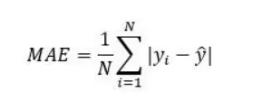
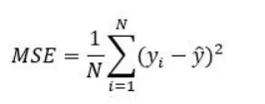
Evaluation Techniques:
Area Under the ROC Curve (AUC-ROC):
Mean Absolute Error (MAE) and Mean Squared Error (MSE):
Cross-Validation:
Measures the trade-off between the true positive rate (sensitivity) and the false positive rate (1 - specificity) across different probability thresholds.
These metrics are used for regression problems and measure the average absolute or squared difference between the predicted and actual values.
Splitting the dataset into multiple subsets and performing training and evaluation on different combinations of these subsets.
It is commonly used for binary classification problems.
This helps assess the model's generalization ability and reduce overfitting.
Notes:
Confusion Matrix: A table that summarizes the predicted and actual class labels, allowing for a more detailed analysis of classification performance, including metrics like true positives, true negatives, false positives, and false negatives.
Domain-specific metrics: Some machine learning projects require customized evaluation metrics tailored to specific industry or application needs. These metrics can include customer churn rate, revenue generated, or precision at certain decision thresholds.

Slide 16
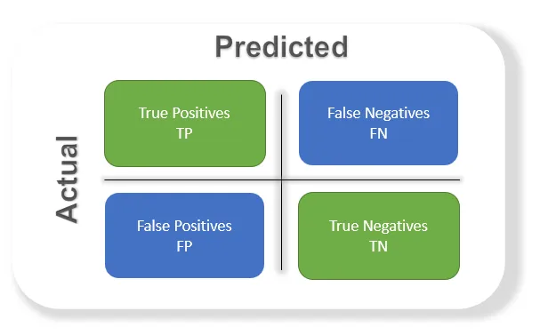
Evaluation Techniques:
Confusion Matrix:
Domain-specific metrics:
A table that summarizes the predicted and actual class labels, allowing for a more detailed analysis of classification performance, including metrics like true positives, true negatives, false positives, and false negatives.
Some machine learning projects require customized evaluation metrics tailored to specific industry or application needs.
These metrics can include customer churn rate, revenue generated, or precision at certain decision thresholds.

Slide 17
Resources:
Aurélien Géron, "Hands-On Machine Learning with Scikit-Learn, Keras, and TensorFlow," O'Reilly Media, 2019.
Max Kuhn and Kjell Johnson, "Applied Predictive Modeling," Springer, 2013.
Alice Zheng and Amanda Casari, "Feature Engineering for Machine Learning: Principles and Techniques for Data Scientists," O'Reilly Media, 2018.
Trevor Hastie, Robert Tibshirani, and Jerome Friedman, "The Elements of Statistical Learning: Data Mining, Inference, and Prediction," Springer, 2009.
Sebastian Raschka and Vahid Mirjalili, "Python Machine Learning," Packt Publishing, 2019.

